Slide 1
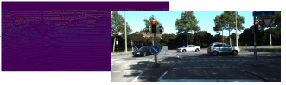
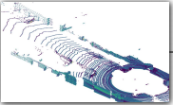
Conv2d encoder
denser depth image
Segmentation Map
concat
decoder
RGB image
pix2pix:
make lidar points denser
by translation
sparse fusion
Classifier
Backbone
Conv2d
Pointpillars:
Voxel feature extractor
detection head
Box Regressor
H
Direction
Classifier
Lidar point cloud
H
W
W
C

Slide 2
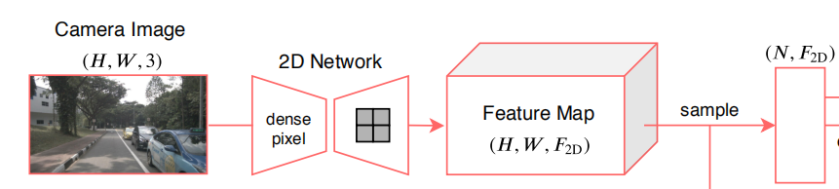
Classifier
(N, num_class* num_anchor_pre_class, H, W)
C=256, H, W
Box Regressor
(N, num_class* num_anchor_pre_class * 7, H, W)
⊕
point_cloud_range = [-50, 0, -5, 50, 50, 3]
voxel_size = [0.25, 0.25, 8]
upsample
C=256, H, W
Direction
Classifier
(N, num_class* num_anchor_pre_class * 2, H, W)
⊕
Pointpillars:
Voxel feature extractor
C=64
upsample
C=256, H, W
200
100
50
25
400
200
100
50
Lidar point cloud
200
400

Slide 3
Img
200, 400

Slide 4
(N, 64+64)
MLP
Fc:(128, num_class)
F_2D=64
(64, H, W)
voxelization
(N, 3)
(64, H, W)
detector
backbone
voxelization
concat
(128, H, W)

Slide 5
(N, 64+4)
MLP
Fc:(68, num_class)
F_2D=64
concat
BEV: (128, H, W)
(N, 4)
(N, 68)
detector
backbone
voxelization

Slide 6
03/24/2021
Contrast_usa_v3, Contrast_usa_v4
Src_contrast_usa_v0

Slide 7
Source_train | Source_test
Src_contrast_usa_v0 (lambda=0.01) | 68.07
Baseline_usa | 68.01

Slide 8
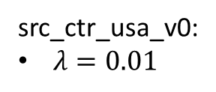
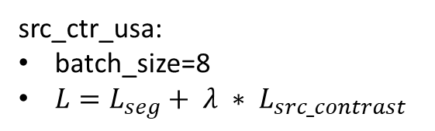
src_ctr_usa:
batch_size=8
$L=L_{seg}+ λ ∗ L_{src_contrast}$
src_ctr_usa_v0:
$λ=0.01$

Slide 9
03/20/2021
Baseline_usa_v1(baseline2_usa)
Contrast_usa_v1

Slide 10
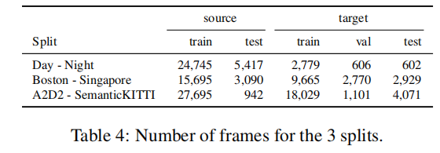
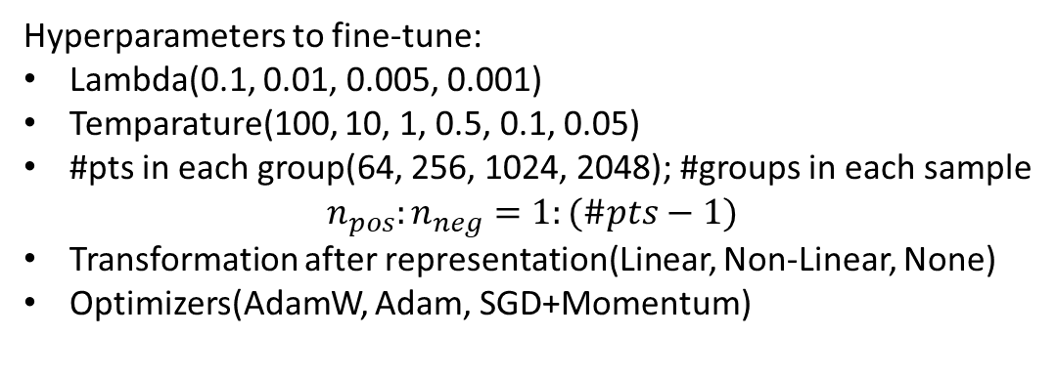
Usa-Sng
Config | Test on target (mIOU)
dual head + KL_div 2D+3D | 62.53
single head 2D+3D | 62.10
baseline_usa_v0 (B=4) | 61.57
baseline_usa_v1 (B=8) | 63.74
contrast_usa_v0 | 52.67
contrast_usa_v1 | 61.69
contrast_usa_v3 | < 60.00
contrast_usa_v4 | < 60.00
Hyperparameters to fine-tune:
Lambda(0.1, 0.01, 0.005, 0.001)
Temparature(100, 10, 1, 0.5, 0.1, 0.05)
#pts in each group(64, 256, 1024, 2048); #groups in each sample
$$n_{pos}:n_{neg}=1:(\#pts−1)$$
Transformation after representation(Linear, Non-Linear, None)
Optimizers(AdamW, Adam, SGD+Momentum)

Slide 11
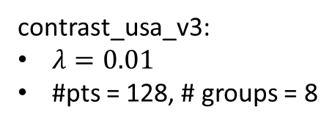
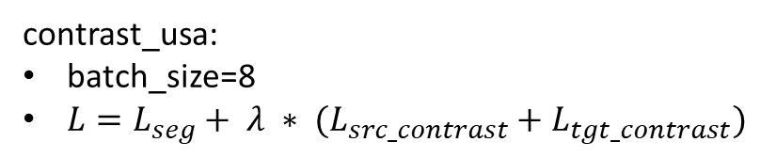
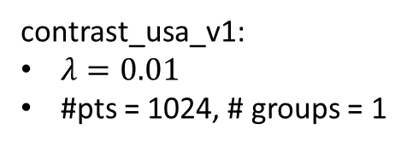
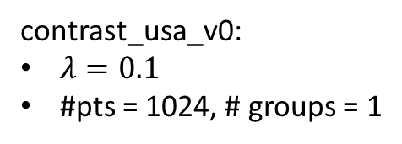
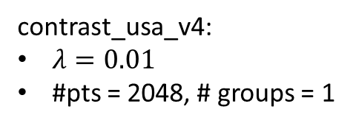
contrast_usa:
batch_size=8
$L=L_{seg}+ λ ∗ (L_{src_contrast}+L_{tgt_contrast})$
contrast_usa_v0:
$λ=0.1$
#pts = 1024, # groups = 1
contrast_usa_v1:
$λ=0.01$
#pts = 1024, # groups = 1
contrast_usa_v3:
$λ=0.01$
#pts = 128, # groups = 8
contrast_usa_v4:
$λ=0.01$
#pts = 2048, # groups = 1

Slide 12
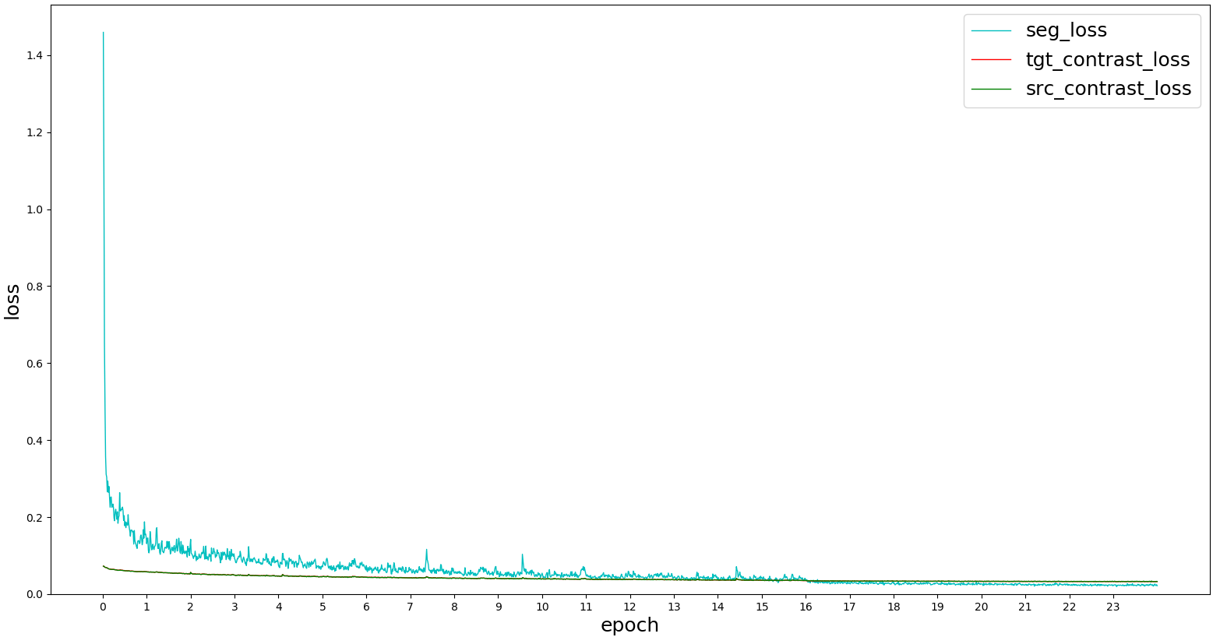
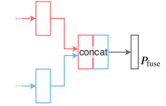
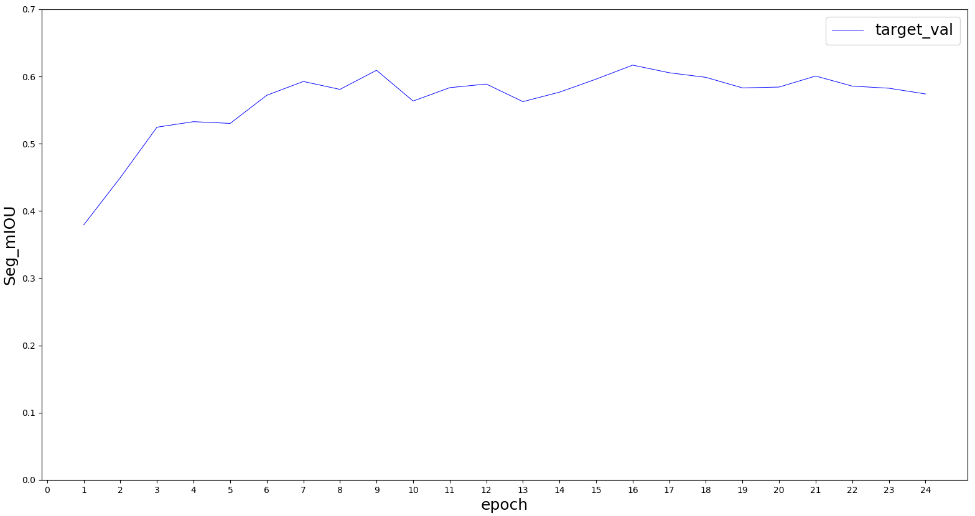
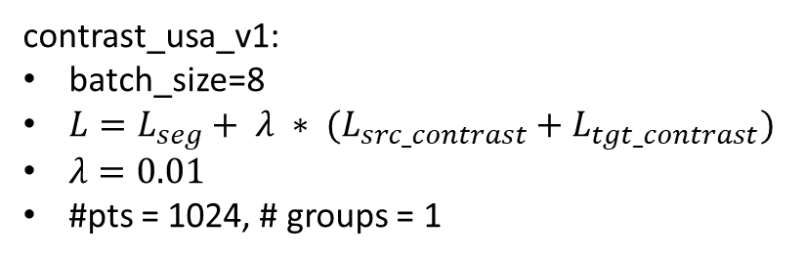
MLP(64, 16)
contrastive_loss
UNetResNet34
(N, 64+16)
(N, 64)
seg_loss
tgt_contrast_loss & src_contrast_loss nearly coincide
UNetSCN
MLP(16, 16)
(N, 16)
contrast_usa_v1:
batch_size=8
$L=L_{seg}+ λ ∗ (L_{src_contrast}+L_{tgt_contrast})$
$λ=0.01$
#pts = 1024, # groups = 1

Slide 13
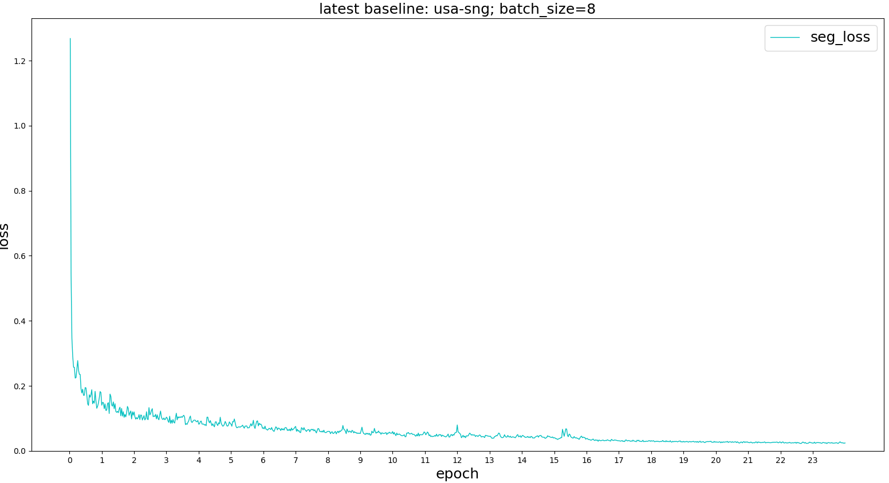
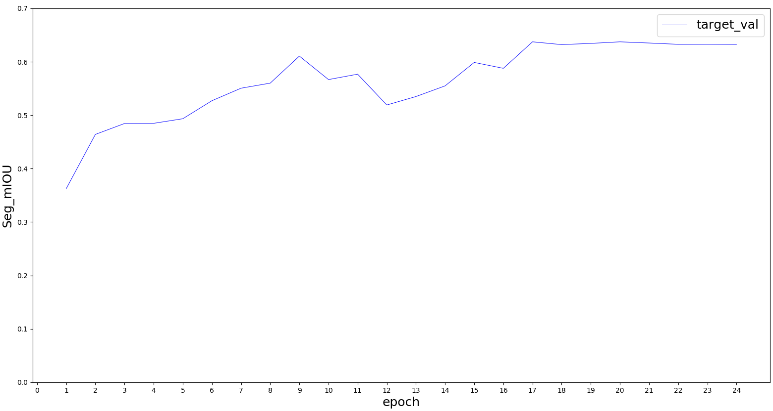
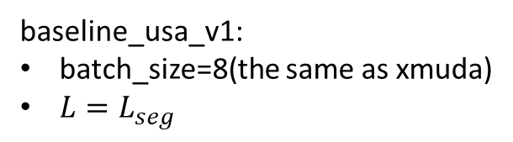
UNetResNet34
(N, 64)
(N, 64+16)
UNetSCN
(N, 16)
Vanilla Fusion(Baseline)
baseline_usa_v1:
batch_size=8(the same as xmuda)
$L=L_{seg}$

Slide 15
03/19/2021
Baseline_usa_v0(baseline1_usa)
Contrast_usa_v0

Slide 16
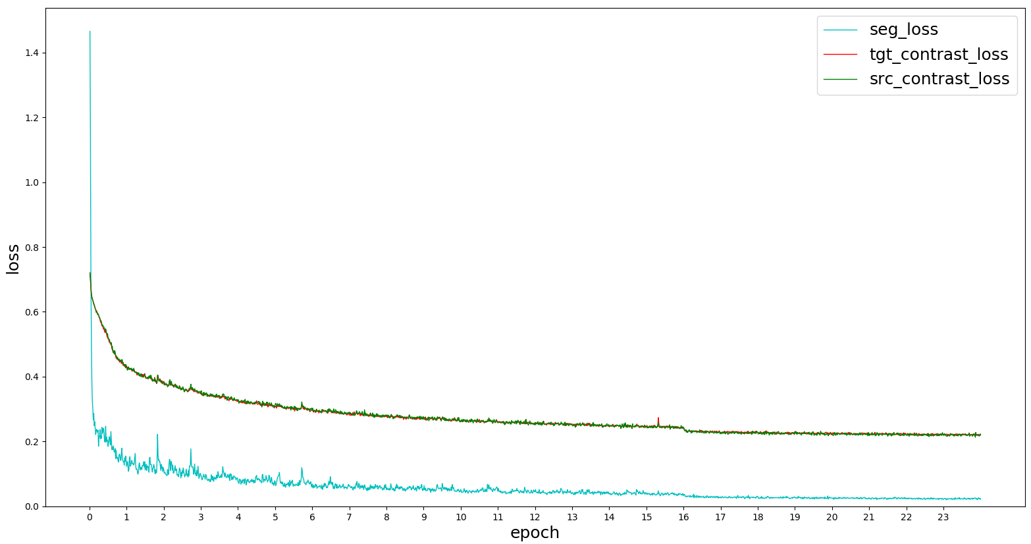
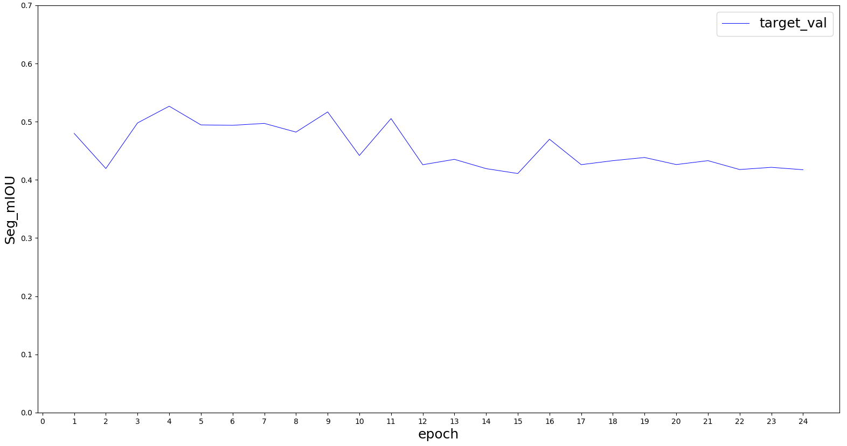
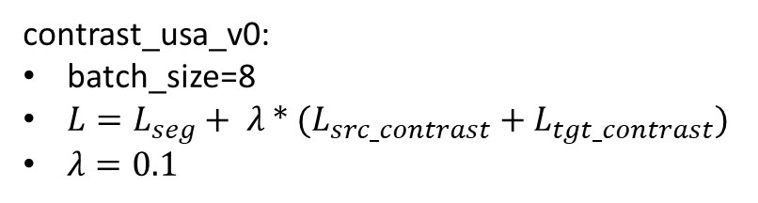
MLP(64, 16)
contrastive_loss
UNetResNet34
(N, 64+16)
tgt_contrast_loss & src_contrast_loss nearly coincide
(N, 64)
seg_loss
UNetSCN
MLP(16, 16)
(N, 16)
contrast_usa_v0:
batch_size=8
$L=L_{seg}+ λ ∗ (L_{src_contrast}+L_{tgt_contrast})$
$λ=0.1$

Slide 17
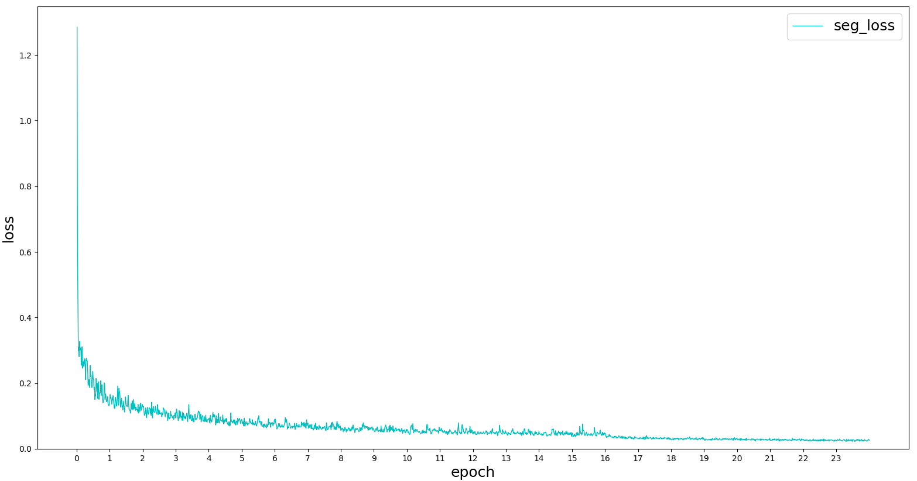
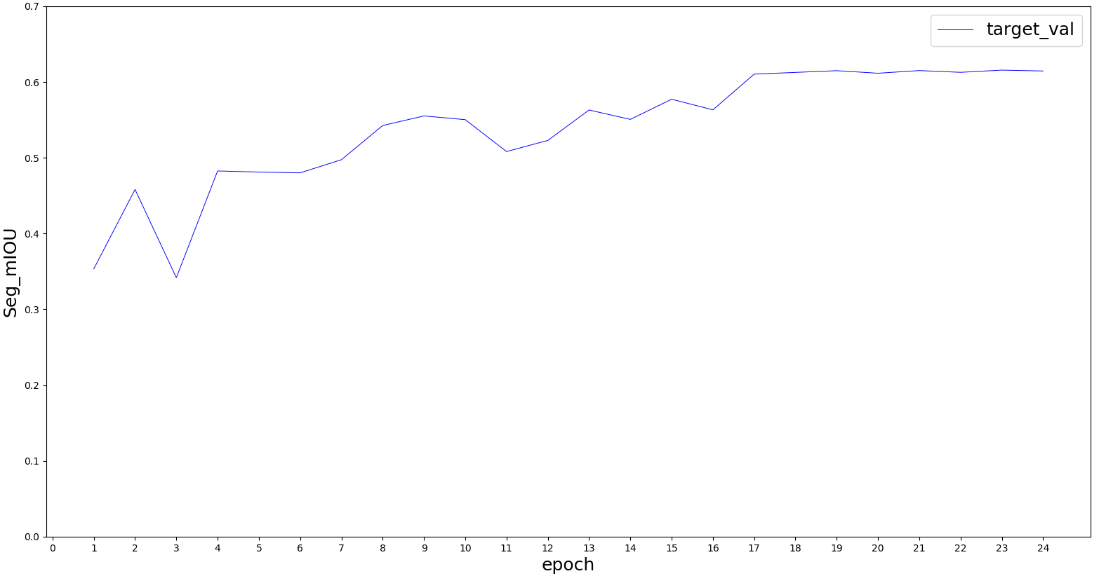
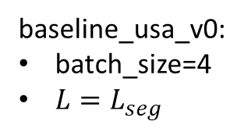
UNetResNet34
(N, 64)
(N, 64+16)
UNetSCN
(N, 16)
Vanilla Fusion(Baseline)
baseline_usa_v0:
batch_size=4
$L=L_{seg}$

Slide 18
03/16/2021
Xmuda new baseline (trained with new seg labels)
“Multi-modal Multi-Task fusion Ver2” baseline
Move xMuda network structure to our framework; train vanilla fusion

Slide 19
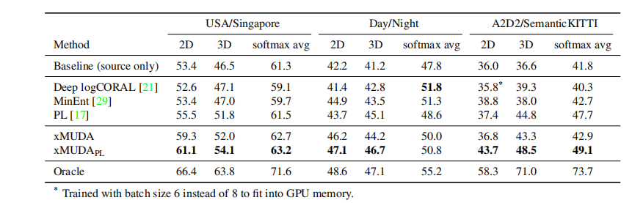
Xmuda, reproduce results using new seg labels
Train/test | Usa/Sng | Usa/Sng |  | Day/night
Segmentation(mIoU) | Xmuda (dual head, KL_div) | Baseline (train on source) | Oracle (train on target) | Xmuda | Baseline | Oracle
2D | 57.04 | 54.03 | 70.83 | 49.62 | 38.81 | 39.30
3D | 53.57 | 48.41 | 65.55 | 45.55 | 43.75 | 46.84
2D+3D | 62.53 | 62.10 | 75.40 | 52.99 | 48.63 | 43.39

Slide 20
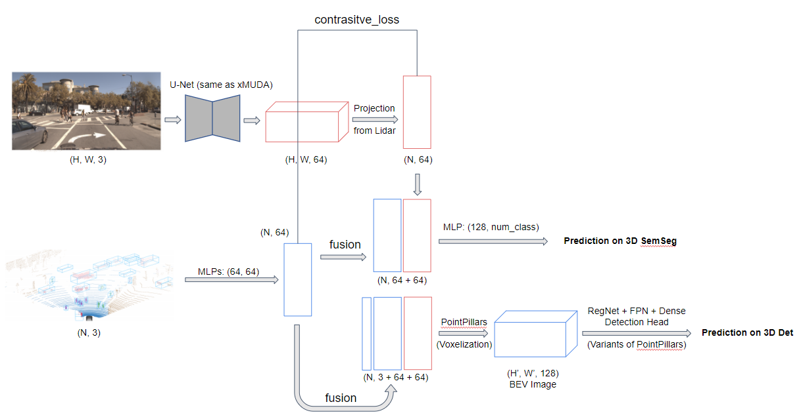
Train/test: Usa/Sng | Ver1 (separate encoders for points) | Multi-modal Multi-Task fusion Ver2 (shared encoder for points)
 | Baseline | Baseline (train on source) | Task_loss + lambda * Contrast_loss (tried a few hyperparameters)
 |  |  | Train from scratch | Resume from baseline model
Segmentation (mIoU) | 60.69 | 62.48 | 48.80 | 57.63
Detection (mAP) | 51.29 | 45.02 | 37.15 | 41.59
Xmuda, new seg labels
Train/test Usa/Sng | Xmuda (dual head， KL_div) | Baseline (separate two streams) | Vanilla fusion
2D | 57.04 | 54.03
3D | 53.57 | 48.41
2D+3D | 62.53 | 62.10 | 63.74
baseline2_usa
UNetResNet34
Multi-modal Multi-Task fusion Ver2
(N, 64)
(N, 64+16)
UNetSCN
(N, 16)
Vanilla Fusion(Baseline)

Slide 21
Some old baselines; Abandoned
Up to now, adversarial methods don’t work with multi tasks(3D Semseg + 3D detection)

Slide 22
Multi-modal Multi-Task fusion
Train/test dataset | Usa/sng | Sng/sng | Day/night | Night/night
Segmentation (mIoU) | 60.69 | 73.47 | 43.67 | 42.24
Detection (mAP) | 51.29 | 68.42 | 52.53 | 40.73
Multi-modal Mutli-task fusion; det supervise seg(Usa/Sng)
Target loss weight | 1.0 | 0.1 | 0.01 | 0.001 | 0.0001 | 0.1 | 0.01
ignore background | F | F | F | F | F | T | T
Segmentation (mIoU) | 27.97 | 27.36 | 39.15 | 58.84 | 59.82 | 19.98 | 21.02
Detection (mAP) | 32.61 | 39.04 | 44.56 | 51.66 | 51.89 | 43.20 | 39.47
Adversarial(Discriminate on the last img feature map)
Train/test | Usa/sng | Day/night
Segmentation (mIoU) | 59.65 | 46.26
Detection (mAP) | 49.39 | 51.60

Slide 23
Train dataset | train_usa |  | train_day
Test dataset | test_usa | test_singapore | test_day | test_night
2D | 66.03 | 54.03 | 70.27 | 38.81
3D | 55.03 | 48.41 | 60.51 | 43.75
2D+3D | 69.12 | 62.10 | 75.56 | 48.63
Train dataset | train_usa |  | train_day
Test dataset | test_usa | test_singapore | test_day | test_night
2D |  | 57.04 |  | 49.62
3D |  | 53.57 |  | 45.55
2D+3D |  | 62.53 |  | 52.99
baseline
xMuda: KLdiv + target
Train dataset | train_usa |  | train_day
Test dataset | test_usa | test_singapore | test_day | test_night
Segmetation (overall_IoU) | 71.76 | 60.27 | 76.00 | 45.45
Detection (mAP) | 68.79 | 50.21 | 73.45 | 51.97
Fusion; with 2D aug & class_weights
old label
Train dataset | train_usa |  | train_day
Test dataset | test_usa | test_singapore | test_day | test_night
Segmetation (overall_IoU) | 59.07 | 50.80 | 65.11 | 41.28
Detection (mAP) | 65.18 | 33.22 | 63.48 | 49.32
Separate; with 2D aug & class_weights

Slide 24
Trash

Slide 25
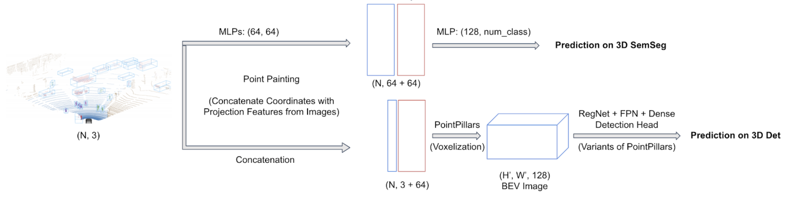
Multi-modal Multi-Task fusion(Usa-sng)
Fusion | Multi-Task | Semseg(mIoU) | 3D Det(mAP)
 |  | 50.80 | 33.22
√ |  | 53.03
√ | √ | 60.69 | 51.29

Slide 26
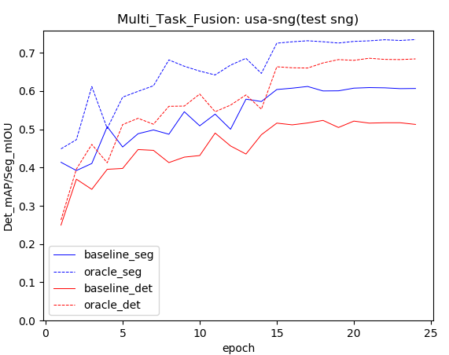
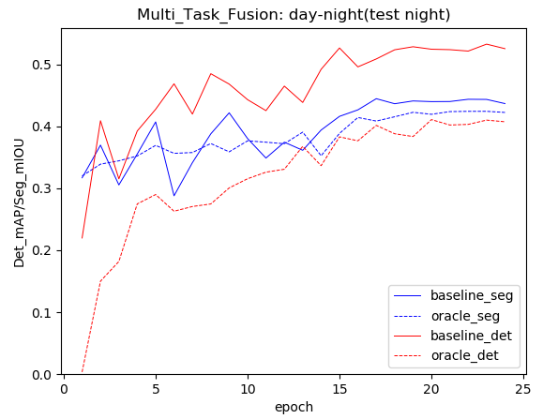
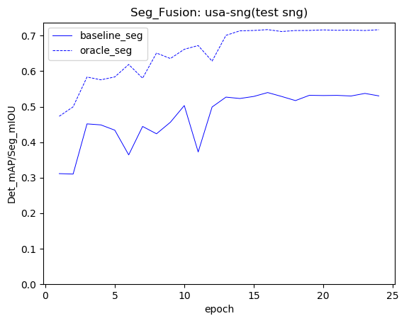
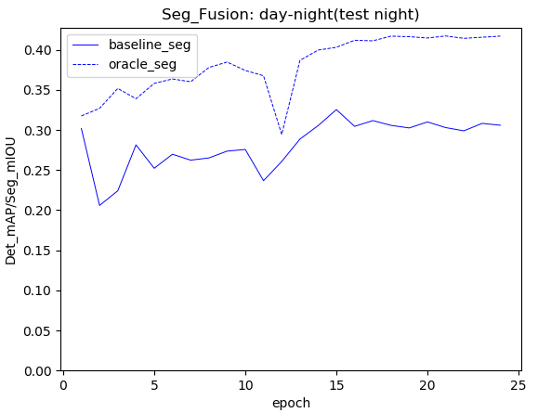

Slide 27
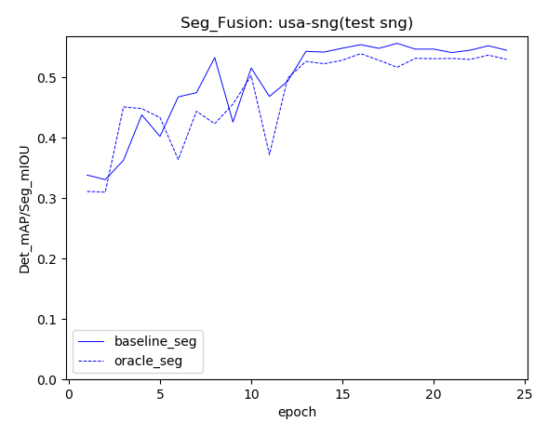

Slide 28
Use points inside 3D pred boxes to supervise 3D Semseg;
Doesn’t work regardless of ignore_background=True or False.

Slide 29
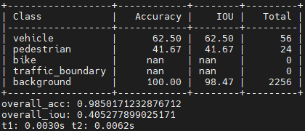
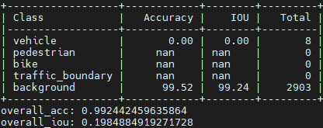
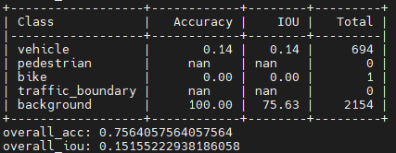
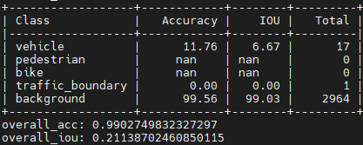
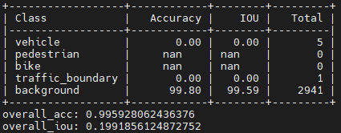
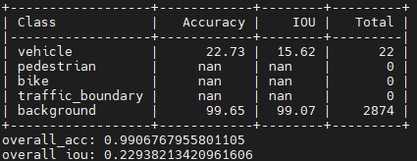
Total: num_real_label

Slide 30
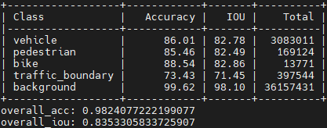
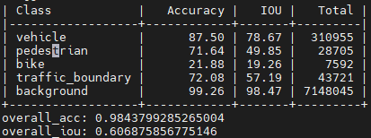
train usa: gt_seg vs pts in gt_box
fusion_usa_rep_new: baseline

Slide 31
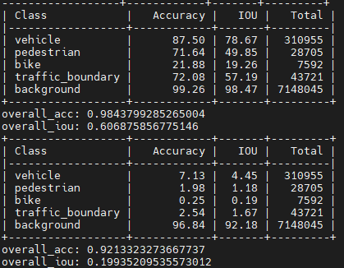
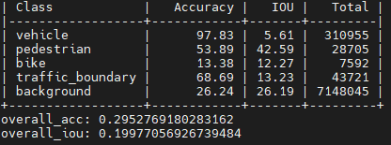
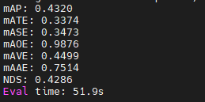
usa-sng
Baseline on target: pred_seg vs pts_in_pred_box
- src_task_loss
Source: pts_in_gt_box
Train_usa_test_sng:
- src_task_loss+target_seg_loss_no_bg

Slide 32
Det:[45.56, 47.10, 46.88, 39.27, 44.31, 42.49, 49.68, 47.73, 48.58, 49.48, 43.68, 50.71, 50.12, 50.76, 51.26, 50.26, 50.89, 50.55, 50.21]
Seg:[54.42, 57.09, 53.51, 35.79, 57.43, 54.98, 59.87, 56.13, 54.80, 58.67, 49.16, 58.43, 59.59, 59.99, 60.22, 59.68, 60.57, 60.39, 60.27]

Slide 33
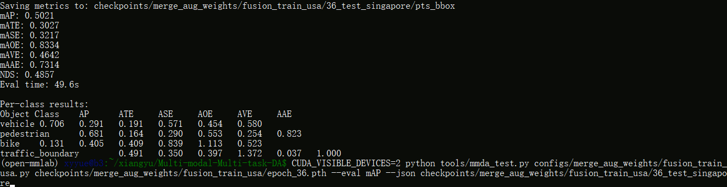
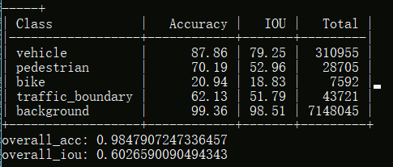

Slide 34
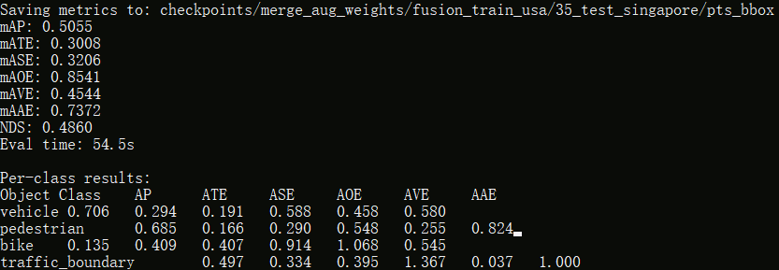
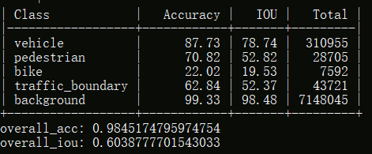
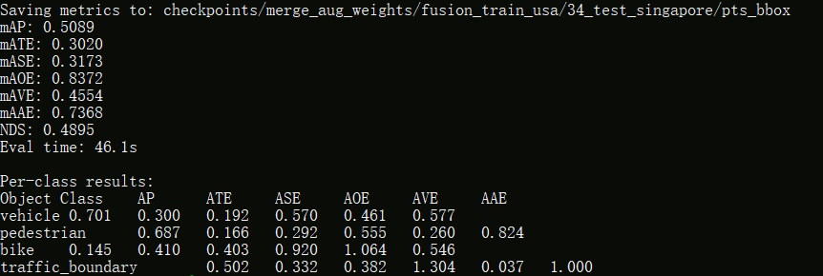
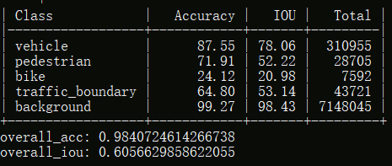

Slide 35





Slide 36





Slide 37





Slide 38





Slide 39





Slide 40





Slide 41





Slide 42





Slide 43
[19, 36]
Seg:[42.79, 41.23, 41.07, 43.18, 40.86, 44.47, 45.13, 41.12, 40.57, 43.80, 45.09, 45.50, 45.66, 45.70, 45.16, 45.58, 45.09, 45.45]
Det:[45.69, 43.37, 41.17, 46.89, 45.11, 53.15, 47.38, 50.23, 48.75, 49.15, 49.85, 48.08, 48.96, 49.60, 51.00, 51.65, 51.56, 51.97]

Slide 44





Slide 45





Slide 46





Slide 47





Slide 48





Slide 49





Slide 50





Slide 51





Slide 52





Slide 53
Separate; with 2D aug & class_weights; epoch_36
Train dataset | train_usa |  | train_day
Test dataset | test_usa | test_singapore | test_day | test_night
Segmetation (overall_IoU) | 59.07 | 50.80 | 65.11 | 41.28
Detection (mAP) | 65.18 | 33.22 | 63.48 | 49.32
4 classes + background
vehicle (car, truck, bus, trailer, construction_vehicle)
pedestrian,
bike (motorcycle, bicycle),
traffic_boundary (traffic_cone, barrier)

Slide 54




Slide 55




Slide 56




Slide 57




Slide 58
Fusion; with 2D aug & class_weights; epoch_36
Train dataset | train_usa |  | train_day
Test dataset | test_usa | test_singapore | test_day | test_night
Segmetation (overall_IoU) | 71.76 | 60.27 | 76.00 | 45.45
Detection (mAP) | 68.79 | 50.21 | 73.45 | 51.97
4 classes + background
vehicle (car, truck, bus, trailer, construction_vehicle)
pedestrian,
bike (motorcycle, bicycle),
traffic_boundary (traffic_cone, barrier)

Slide 59




Slide 60




Slide 61




Slide 62


Slide 63
xMuda: xmuda, KL divergence
Differences:
test target with best validation
num_points(cone vs triangle(rectangle & cone))
Train dataset | train_usa |  | train_day
Test dataset | test_usa | test_singapore | test_day | test_night
2D |  | 57.04 |  | 49.62
3D |  | 53.56 |  | 45.55
2D+3D |  | 62.49 |  | 52.99
4 classes + background
vehicle (car, truck, bus, trailer, construction_vehicle)
pedestrian,
bike (motorcycle, bicycle),
traffic_boundary (traffic_cone, barrier)

Slide 64




Slide 65



Best val:
2d_035000
3d_095000

Slide 66
xMuda: baseline, without KL divergence
Differences:
2D aug & class_weights
test target with best target validation
test source with last checkpoint
num_points(cone vs triangle(rectangle & cone))
Train dataset | train_usa |  | train_day
Test dataset | test_usa | test_singapore | test_day | test_night
2D | 66.03 | 54.03 | 70.27 | 38.81
3D | 55.03 | 48.41 | 60.51 | 43.75
2D+3D | 69.12 | 62.10 | 75.56 | 48.63
4 classes + background
vehicle (car, truck, bus, trailer, construction_vehicle)
pedestrian,
bike (motorcycle, bicycle),
traffic_boundary (traffic_cone, barrier)

Slide 67




Slide 68


Slide 69




Slide 70


Slide 71
Separate; without 2D aug & class_weights
Train dataset | Nuscenes train | train_usa |  | train_day
Test dataset | Nuscenes val | test_usa | test_singapore | test_day | test_night
Segmetation (overall_IoU) | 66.62 | 61.36 | 31.64 | 67.01 | 27.79
Detection (mAP) | 64.01 | 66.25 | 33.21 | 63.43 | 43.51
4 classes + background
vehicle (car, truck, bus, trailer, construction_vehicle)
pedestrian,
bike (motorcycle, bicycle),
traffic_boundary (traffic_cone, barrier)

Slide 72




Slide 73




Slide 74




Slide 75



Slide 76



Slide 77
Fusion, without 2D aug & class_weights
Train dataset | Nuscenes train | train_usa |  | train_day
Test dataset | Nuscenes val | test_usa | test_singapore | test_day | test_night
Segmetation (overall_IoU) | 73.82 | 67.16 | 50.78 | 73.96 | 36.27
Detection (mAP) | 72.15 | 71.12 | 46.60 | 71.79 | 49.25
4 classes + background
vehicle (car, truck, bus, trailer, construction_vehicle)
pedestrian,
bike (motorcycle, bicycle),
traffic_boundary (traffic_cone, barrier)
Todo: Without fusion
Xmuda: new seg label(baseline, KL div)

Slide 78



Slide 79



Slide 80



Slide 81



Slide 82



Slide 83



Slide 84
10 classes + background; without 2D aug & class_weights
Train dataset | Nuscenes train(fusion) | Nuscenes train(No fusion) | train_usa(fusion) |  | train_day(fusion)
Test dataset | Nuscenes val | Nuscenes val | test_usa | test_singapore | test_day | test_night
Segmetation (overall_IoU) | 60.8 | 54.4 | 54.7 | 33.1 | 61.2 | 17.7
Detection (mAP) | 54.7 | 47.1 | 52.8 | 29.3 | 54.0 | 20.0

Slide 85



single img segmentation
single lidar detection

Slide 86


Img_seg_head after fusion: 68, 34, num_classes

Slide 87


old validation: 为什么缺了一个barrier(0.538那个倒是没缺)

Slide 88




Slide 89



Slide 90



Slide 91




Slide 92


train_usa, test_usa

Slide 93


train_usa, test_singapore

Slide 94


train_day, test_day

Slide 95


train_day, test_night

